Slide 1

Database Systems
SQL COMMANDS
SQL SERVER & C#
Presented By: Absar Ahmed - 231

Slide 2
To Cover
SQL COMMANDS TO INTERACT WITH OUR DATA AT SQL SERVER
SQLDataAdapter
SQLData - DataReader - ExecuteReader
DataTable
DataSet
ExecuteNonQuery
ExecuteScalar

Slide 3
Commands & their Use
EXECUTESCALAR
EXECUTEREADER
Returns an object from data retrieval.
Return all rows from data retrieval.
Use to Retrieve a single value from Database accessed by query.
Stores Rows in RDR object that can be accessed using read().
EXECUTENONQUERY
SQLDATAADAPTER
DATATABLE
Executes SQL Command
Connects Query and SQL Connection
Creates a Data Table
Interacts with Database and Apply Query.
Data Table is Filled By SQL Data Adapter
Returning object fills the datatable with executed query.

Slide 4

SQL Connection
Creates a Connection object of Connecting Database - SQL Server - & Project in use to proceed Data Operations.
SQL Command
Creates a SQL Query as Command that is executed through the Connection terminals (open & close)

Slide 5
DataSet/DataTable
ExecuteReader/Scalar/NonQuery
Connection Less - Works with DataAdapter
Doesn’t Require Connection Open & Close
Connection Oriented
Requires Connection to Open & Close
Used to Extract Data from Database
Used to Execute an SQL Query to connected Database
Typically Used to Extract Data from Database
Typically Used to Execute Queries (NonQuery)

Slide 6
Syntax &
How to Use
EXECUTE SCALAR
object obj = cmd.ExecuteScalar();
string text = obj.ToString();
EXECUTE READER
SqlDataReader rdr = cmd.ExecuteReader();
rdr.Read();
string s1 = rdr["Col1"].ToString();
string s2 = rdr["Col2"].ToString();
EXECUTE NON QUERY
c.Open();
cmd.ExecuteNonQuery();
c.Close();

Slide 7
SQL DATA ADAPTER
Syntax &
How to Use
SqlDataAdapter sda = new SqlDataAdapter(query, connection);
DataTable dt = new DataTable(); // DataSet ds = new DataSet();
sda.Fill(dt); //sda.Fill(ds, "table_name");
SQL DATASET
DataSet ds = new DataSet();
sda.Fill(ds, "student");
string s1 = ds.Tables["table"].Rows[0]["col"].ToString();
string s2 = ds.Tables["table"].Rows[1]["col"].ToString();
SQL DATA TABLE
DataTable dt = new DataTable();
sda.Fill(dt);
string s1 = dt.Rows[0]["Col1"].ToString();
string s2 = dt.Rows[0]["Col2"].ToString();

Slide 8


SQL Database Table - Student

Slide 9
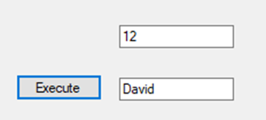
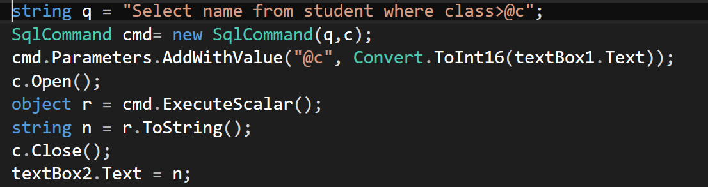

Execute Scalar
RETURNS AN OBJECT FROM DATA
Use to Retrieve a single value from Database accessed by query.

Slide 10
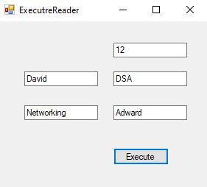
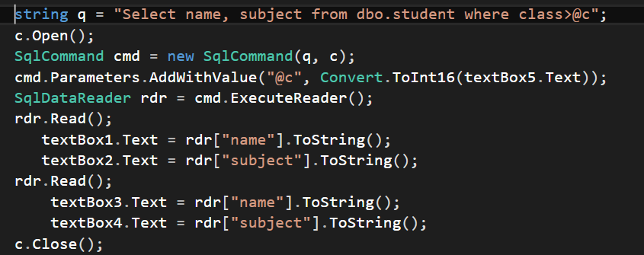
Execute Reader
RETURN ALL ROWS FROM DATA
Stores Rows in RDR object that can be accessed using read().

Slide 11

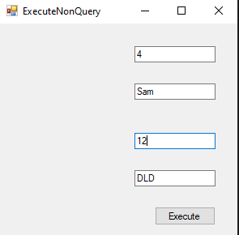
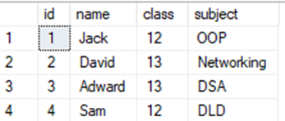
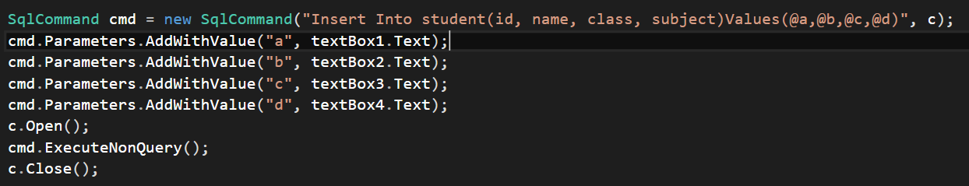
Execute NonQuery
EXECUTES SQL COMMAND
Interacts with Database and Apply Query.

Slide 12

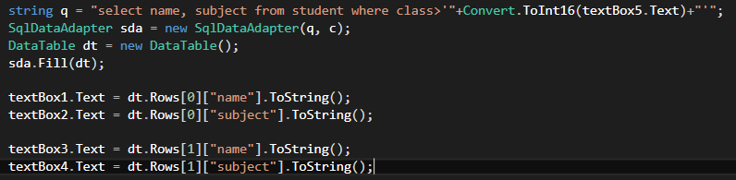
SQL Data Adapter
CONNECTION LESS DATA ACCESS
SQL Data Adapter is a Connection bridge to SQL Server & Query to Extract Data from Database

Slide 13
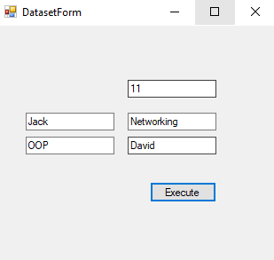
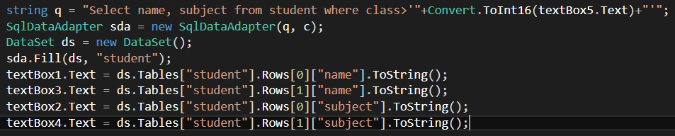
Execute DataSet
RETURN TABLE AS DATASET FROM DATA
Stores Table in dataset object and data can be accessed by row number and column name.

Slide 14
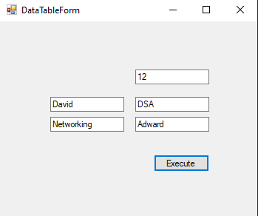
DataTable
CREATES A DATA TABLE IN MEMORY
Data Table is Filled By SQLDataAdapter

Slide 15

Do you have any questions?
Send it to us! We hope you learned something new.
Greets :)

